Slide 1
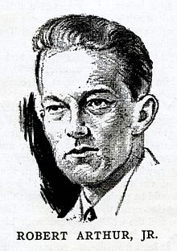

THE MID-NIGHT VISITOR
BY:
ASIJA ANAND 10TH – “A”

Slide 2
CHARACTERS
AUSABLE WAS A RATHER FAT SECRET AGENT. IN THIS STORY HE REPRESENTS HIS WITS WITH THE HELP OF HIS IMAGINATION WHICH LATER PROVIDED THE PROOF THAT AN AGENT IS FAMOUS BECAUSE OF ITS INTELLIGENCE AND NOT BECAUSE OF HIS BODY TEXTURE…
FOWLER WAS AN ADVENTURIST AND A WRITER WHO CAME VISITED AUSIBLE TO COMPREHEND THE LIFE OF A SPY…
MAX,HE WAS ANOTHER SECRET AGENT WHO VISITED THE STORY AT ITS CLIMAX.

Slide 3
GLOSSARY
PASSABLY: JUST WELL ENOUGH; TOLERABLY WELL
ESPIONAGE: SPYING
SLOPPY: (HERE) CARELESSLY DRESSED PROSAIC: ORDINARY
CHUCKLED: LAUGHED QUIETLY, WITHOUT OPENING HIS MOUTH
WHEEZED: SPOKE BREATHING NOISILY AND HEAVILY
MISSILES: WEAPONS DIRECTED BY REMOTE CONTROL OR AUTOMATICALLY
SHRILLY: PIERCINGLY; IN A HIGH PITCH
ROMANTIC: IMAGINATIVE; HAVING A FANTASTIC VIEW OF REALITY

Slide 4
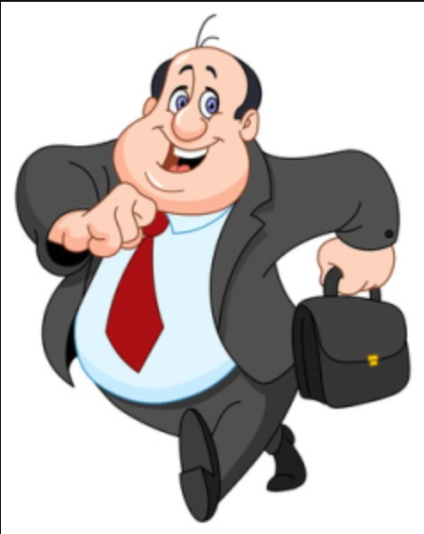
PLOT
AUSABLE IS A VERY FAT MAN AND SURELY DOSN’T FITS INTO THE PICTURE OF A SECRET AGENT ACCORDING TO FOWER WHO WAS WITH AUSABLE WITH THE HOPE OF WITNESSING SOME FABULOUS DOINGS OF A AGENT. FOWER WAS DEPRESSED. HE COULD NOT FIND ANYTHING SPECIAL AND THOUGHT THAT HIS DAY WAS WASTED BUT NEVERTHELESS AUSABLE SAID THAT HE WILL SHOW HIM SOME REPORTS WHICH COULD CHANGE THE TRACK OF THE WHOLE NATION.

Slide 5
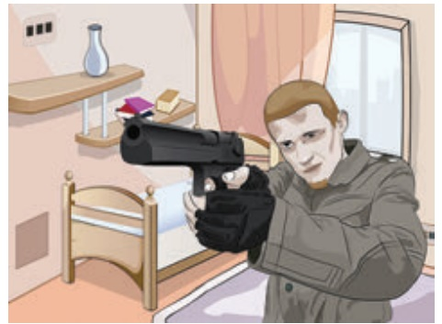
PLOT
AUSABLE WAS LIVING IN A HOTEL ROOM. IT WAS A SMALL ROOM, ON THE SIXTH AND TOP FLOOR. WHEN AUSABLE AND FOWER ENTERED THE ROOM THEY MET WITH MAX, ANOTHER INDERCOVERED SECRET AGENT. HE WAS AFTER THE REPORTS AND WAS HOLDING A GUN POINTING TOWARDS AUSIBLE. FOWER BECAME EXCITED WITH THE IDEAS OF GUNS, SHOOTING, FIGHTING ETC.

Slide 6
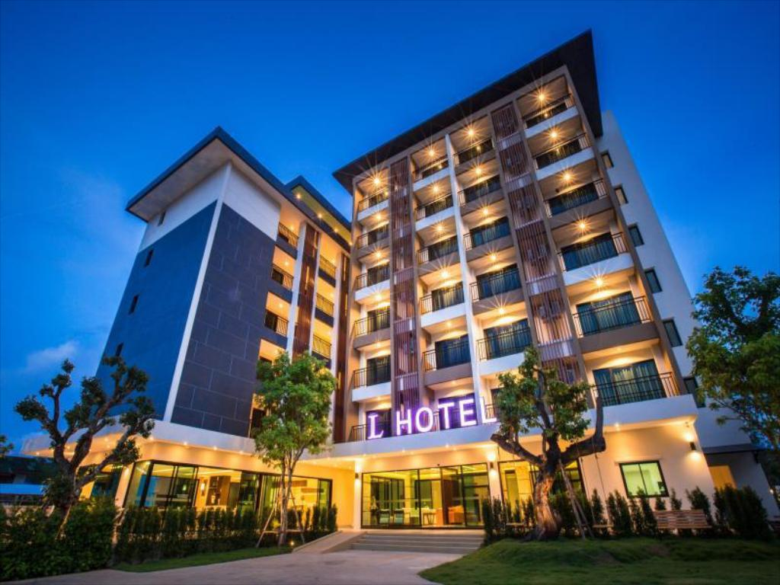
PLOT
WHILE THEY WERE TALKING, AUSABLE STARTED WITH A STORY ABOUT HOW A GUY HAD ENTERED FROM THE BALCONY LAST MONTH BELOW HIS ROOM. WHILE THIS TALK WAS GOING ON, A SUDDEN KNOCK WAS HEARD AT THE DOOR. AUSABLE SAID THAT IT MUST BE THE POLICE AS HE WANTED THEM TO CHECK ON HIM AFTER SOMETIME BECAUSE HE WANTED TO MAKE THE REPORTS THAT WERE COMING IN EXTRA SECURE. MAX, POINTING HIS GUN TOWARDS THEM, SAID THAT HE WOULD BE WAITING IN THE BALCONY AND THAT AUSABLE SHOULD SEND AWAY THE POLICE OTHERWISE HE WOULD SHOOT THEM AND EVEN TAKE THE RISK OF BEING CAUGHT BY THE POLICE.

Slide 7

PLOT
AS THE DOORKNOB IS TURNED, MAX JUMPS OUT OF THE WINDOW AND A LOUD SCREAM IS HEARD. THE DOOR OPENS AND A WAITER COMES IN AND SAYS THAT HE HAS BROUGHT THE WINE THAT MR. AUSABLE HAD ORDERED. HE KEEPS THE BOTTLE, TRAY AND GLASSES ON THE TABLE AND LEAVES. FOWLER IS SURPRISED AND ASKS HIM ABOUT THE POLICE TO WHICH AUSABLE REPLIED THAT THERE WAS NO POLICE. THEN FOWLER ASKED WHAT ABOUT THE PERSON WHO WAS WAITING IN THE BALCONY OUTSIDE THE WINDOW TO WHICH AUSABLE REPLIED THAT THE PERSON WOULD NOT RETURN AND THAT THERE WAS NO BALCONY THERE.

Slide 8
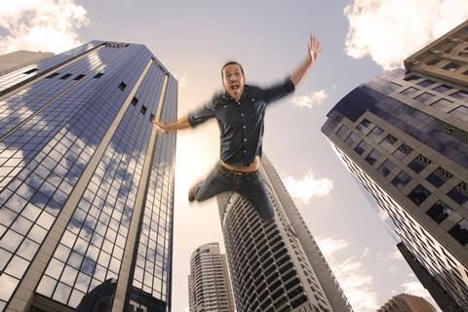
PLOT
THIS SHOWS THE QUICK WIT OF AUSABLE AS HE TOOK ADVANTAGE OF THE SITUATION AND MADE MAX NERVOUS DUE TO WHICH HE JUMPED OUT OF THE WINDOW WITHOUT THINKING AND LOOKING DOWN. HE HAD JUMPED FROM THE TOP FLOOR OF THE HOTEL AND WOULD HAVE POSSIBLY DIED. THIS IS HOW AUSABLE OUTWITTED MAX AND SAVED HIMSELF FROM A VERY DANGEROUS SITUATION."

Slide 9
THANK YOU

